Slide 1
Chapter 14 Organic reactions

Slide 3
Type of reactions
Addition: Reactions occur when two reactants combine to form a single product.
The most important characteristic of unsaturated compounds.

Slide 4
Elimination: Reactions result in the removal of a small molecule (normally H₂O, HX, etc.) from a larger one.
Can be considered as the reverse reaction of addition.
for example
C₂H₅OH → C₂H₄ + H₂O
conc. H₂SO₄
heat

Slide 5
Substitution: Reactions occur when one atom or group of atoms in a compound is replaced by a different atom or group.
for example
CH₄ + Cl₂ → CH₃Cl + HCl

Slide 6
Condensation: Reactions occur when two reactants join together and in the process a small molecule such as H₂O, HCl, or NH₃ is lost
Reaction occurs between a functional group in each reactant
Can be considered as one type of substitution, also called addition-elimination reaction

Slide 7
Hydrolysis: The reactions involve the breakdown of an organic molecule by water to form another organic molecule and another small molecule.
This type of reactions is often accelerated by the addition of alkali or acid.
Sometimes can be considered as the reverse reaction of condensation.
for example
CH₃COOC₂H₅ + H₂O → CH₃COOH + C₂H₅OH
H⁺

Slide 8
Oxidation: Reactions that involve the addition of oxygen atom(s) or the removal of hydrogen atom(s) from the organic molecules.
for example
3 CH₃CH₂OH + 2 Cr₂O₇²⁻ + 16 H⁺ → 3 CH₃COOH + 4 Cr³⁺ + 11 H₂O
OR
CH₃CH₂OH + 2 [O] → CH₃COOH + H₂O
where [O] refer to any oxidant that provides one oxygen atom.

Slide 9
Reduction: Reactions that involve the addition of hydrogen atom(s) or the removal of oxygen atom(s) from the organic molecules.
Can be considered as the reverse reaction of oxidation.
for example
4 CH₃COCH₃ + NaBH₄ + 4 H₂O → 4 CH₃CH(OH)CH₃ + H₃BO₃ + NaOH
OR
CH₃COCH₃ + 2 [H] → CH₃CH(OH)CH₃
where [H] refer to any reductant that provides one hydrogen atom.

Slide 10
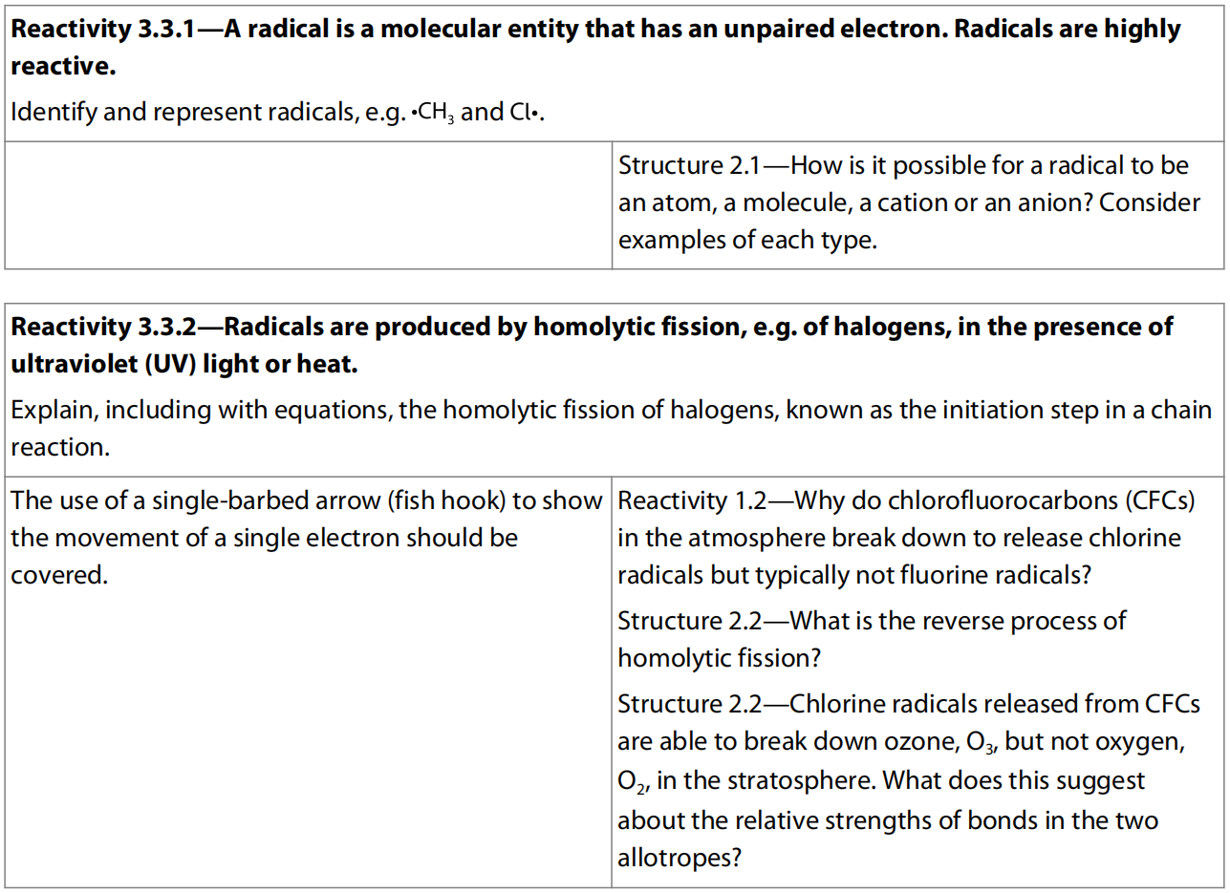
14.1 Free Radical Substitution

Slide 11
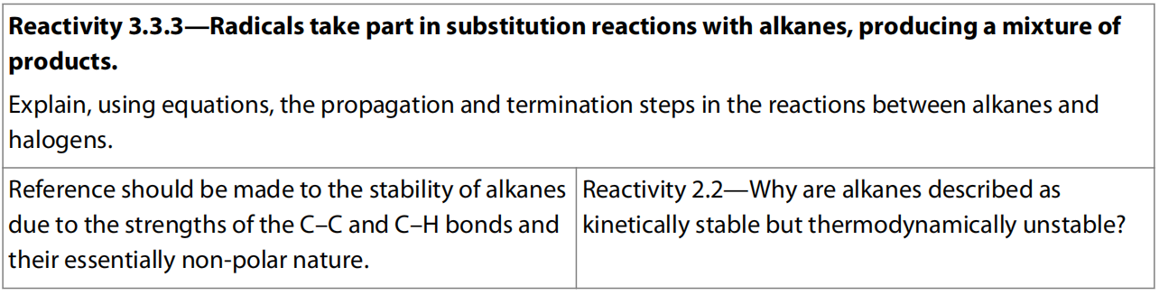

Slide 12
Alkane
Alkanes are saturated hydrocarbons with general formula of C_{n}H_{2n+2}.
Alkanes are saturated because they contain only carbon–carbon single bonds.
Alkanes contain only C –– C and C –– H bonds, which are both strong bonds: C –– C = 348 kJ mol^{–1} and C –– H = 412 kJ mol^{–1}.
So these molecules only react in the presence of a strong source of energy, strong enough to break these bonds.
As a result, alkanes are stable under most conditions and can be stored, transported, and even compressed safely, which is one of the reasons why they are such useful compounds.

Slide 13
The C –– C and C –– H bonds are also characteristically non-polar, so these molecules are not susceptible to attack by most common reactants.
These two factors taken together mean that alkanes are generally of very low reactivity.
There are only two reactions involving alkanes that we will consider here – combustion and substitution reactions.
Combustion reaction has be covered in previous chapter.

Slide 14
Free Radical Substitution reactions of alkanes: halogenation
As alkanes are saturated molecules, the main type of reaction that they can undergo is substitution.
This occurs when another reactant, such as a halogen, takes the place of a hydrogen atom in the alkane.
For example, methane, CH₄, reacts with chlorine producing chloromethane and hydrogen chloride.

Slide 15
The reaction does not take place in the dark as the energy of UV light is necessary to break the covalent bond in the chlorine molecule.
This splits it into chlorine atoms, which each have an unpaired electron and are known as free radicals.
Once formed, these radicals will start a chain reaction in which a mixture of products including the halogenoalkane is formed.
We can describe the reaction as a sequence of steps, known as the reaction mechanism.

Slide 16
Initiation
This process occurs in the presence of ultra-violet light.
It is known as photochemical homolytic fission because the bond between the chlorine atoms is broken, splitting the shared pair of electrons between the two atoms.
This process can be shown using single-sided curly arrows, sometimes known as ‘fishhooks’, to show the movement of a single electron.

Slide 17
Propagation
Propagation reactions both use and produce free radicals.
There are many possible propagation steps, which all allow the reaction to continue.
This is why this type of reaction is often called a chain reaction.

Slide 18
Termination
Termination reactions remove free radicals from the mixture by causing them to react together and pair up their electrons.
Again there are many possible termination steps.

Slide 19
Free Radical Substitution Summary
It requires UV light as the condition
Initiation: X₂ → 2 X·
Propagation: X· + RH → R· + HX R· + X₂ → RX + X·
Termination: X· + X· → X₂ X· + R· → RX R· + R· → RR

Slide 20
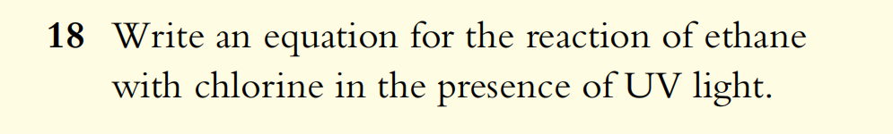
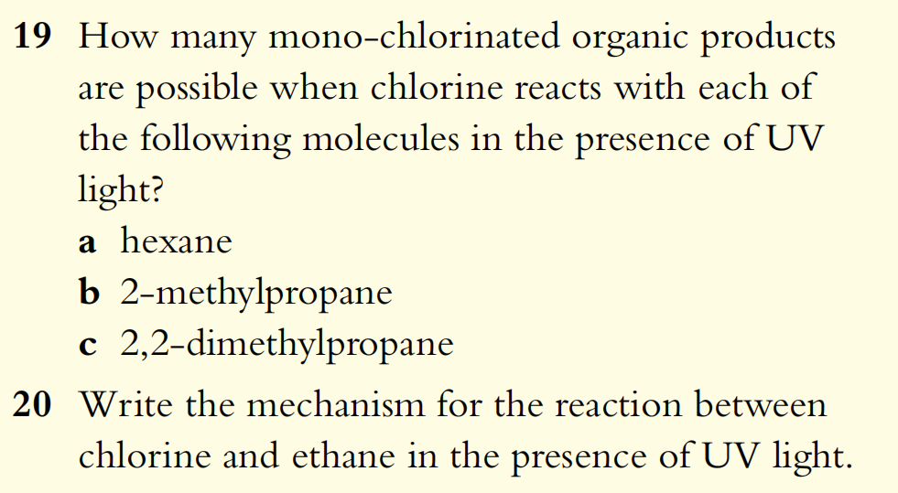

Slide 21
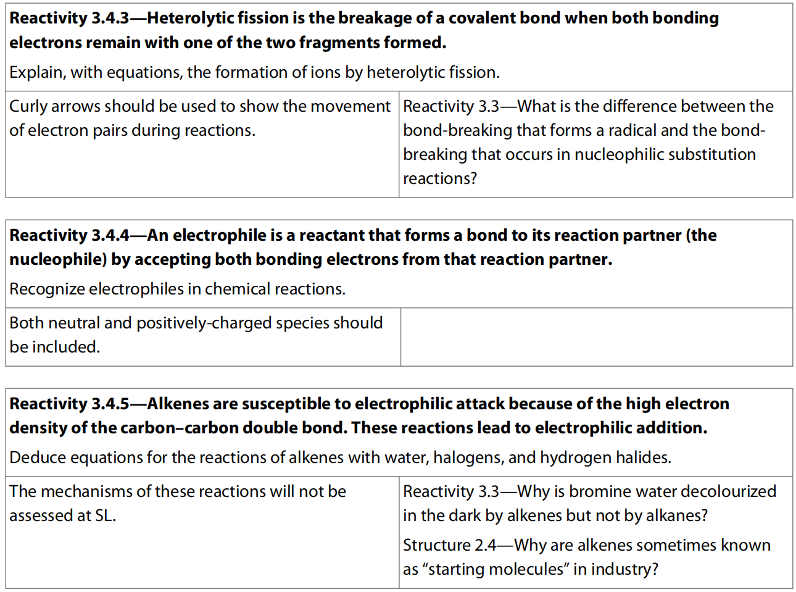
14.2 Electrophilic Addition

Slide 22
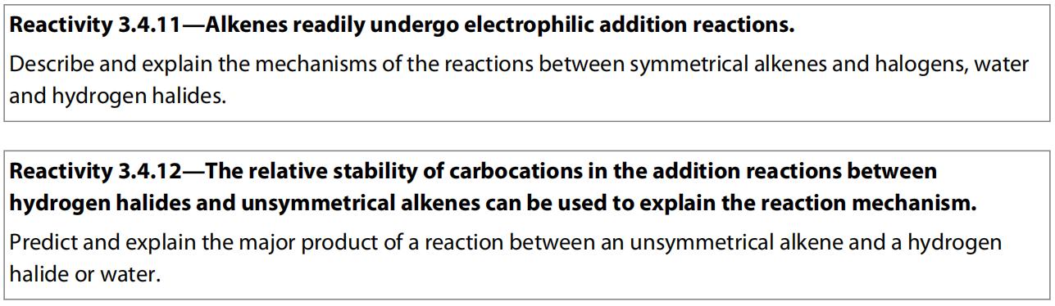
HL Only
HL Only

Slide 23
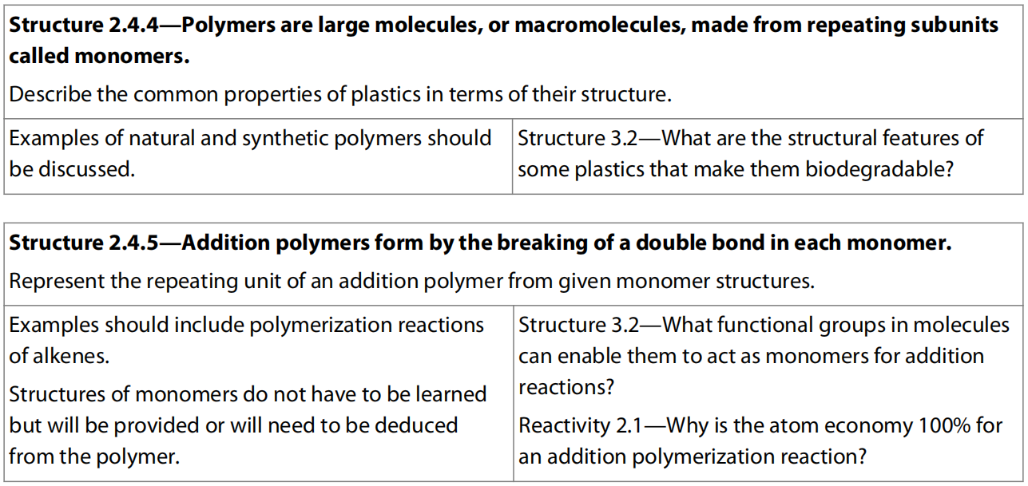

Slide 24
Alkenes
General formula C_{n}H_{2n}.
Alkenes are unsaturated hydrocarbons containing a carbon–carbon double bond.
the double bond is made of two different bonds, one σ, and one π, and the carbon atoms are sp² hybridized, forming a triangular planar shape with angles of 120°.

Slide 25
Electrophilic Addition
Alkenes are more reactive than alkanes as the double bond is the site of reactivity of the molecule.
The π bond is relatively easily broken, which creates two new bonding positions on the carbon atoms.
This enables alkenes to undergo addition reactions and so form a range of different saturated products.
Since the electron density of the C=C double bond is higher than normal C-C single bond, this kind of addition reactions is specifically called electrophilic addition, which means an electrophile is needed as the other reagent.

Slide 26
The carbon atoms of the double bond are sp² hybridized, forming a planar triangular shape, with bond angle 120°.
This is a fairly open structure that makes it relatively easy for incoming groups to attack.
The π bond represents an area of electron density above and below the plane of the bond axis.
Because electrons in the π bond are less closely associated with the nuclei, it is a weaker bond than the σ bond and so breaks more easily during the addition reactions.
Because it is an area of higher electron density, the π bond in the C=C double bond is attractive to electrophiles, species that either are cations or are with partial positive charge.

Slide 27
When this bond breaks, reactants attach at each carbon atom:
Reactions between these reagents and alkenes are therefore known as electrophilic addition reactions.
Good examples include the addition of halogens and hydrogen halides to alkenes, which happen readily under mild conditions (room temperature and pressure).
In these reactions the electrophile is produced through heterolytic fission, as described in detail in the following examples.

Slide 28
Addition of water
The reaction with water is known as hydration, and converts the alkene into an alcohol.
In the laboratory, it can be achieved using sulfuric acid as a catalyst.
The reaction involves a carbocation intermediate in which H⁺ ion is added on one of the carbon atom on the double bond, but this is quickly followed by addition of water molecule on the other carbon and the extra H⁺ ion is easily removed afterwards.
Conditions: heat with steam and catalyst of conc. H₂SO₄
This reaction is of industrial significance because ethanol is a very important solvent, and so is manufactured on a large scale.

Slide 29
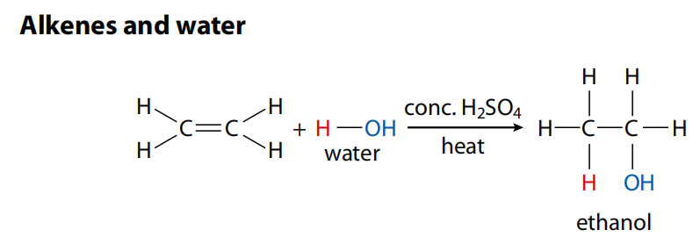

Slide 30
Addition of halogens
Halogens react with alkenes to produce dihalogeno compounds.
These reactions happen quickly at room temperature, and are accompanied by the loss of colour of the reacting halogen.
Note that the name and structure of the product indicates that a halogen atom attaches to each of the two carbon atoms of the double bond.

Slide 31
Mechanism
Bromine is a non-polar molecule, but as it approaches the electron rich region (π bond) of the alkene, it becomes polarized by electron repulsion.
The bromine atom nearer the alkene’s double bond gains a δ+ charge and acts as the electrophile.
Note the curly arrow is always drawn in the direction in which the electron pair moves.
The bromine molecule splits heterolytically, forming Br⁺ and Br⁻, and the initial attack on the ethene in which the π bond breaks is carried out by the positive ion, Br⁺.

Slide 32
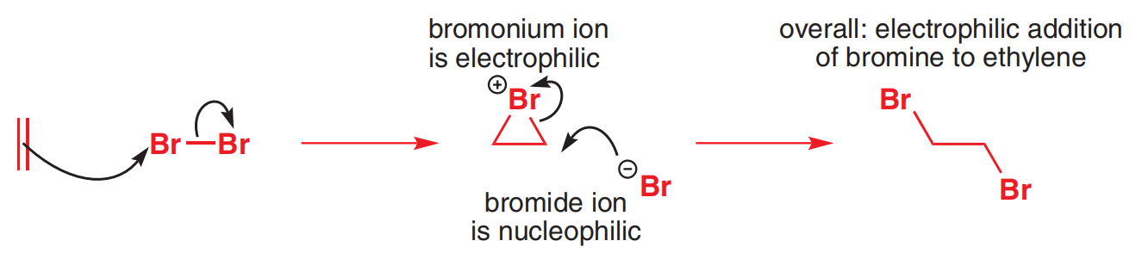
This step is slow, resulting in an unstable carbocation intermediate in which the carbon atom has a share in only six outer electrons and carries an overall positive charge.
This unstable species then reacts rapidly with the negative bromide ion, Br⁻, forming the product 1,2-dibromoethane.

Slide 33
The bromine test
The reaction between alkene and bromine (with brown color) would produce colorless products.
The change in color from brown to colorless of bromine when it reacts with alkanes occurs only in the presence of UV light, but halogenation of alkenes occurs under room temperature.
Therefore, this reaction is sometimes used to distinguish between alkanes and alkenes.
Alkene: bromine water – orange to colourless
Alkane: bromine water – no colour change

Slide 34
The tube on the right contains cyclohexene that has reacted with bromine water and decolorized it.
This is because it contains a reactive double bond.
The tube on the left contains benzene, which has not decolorized the bromine water.
Although it is unsaturated, benzene does not readily undergo addition reactions due to its stable aromatic ring structure.

Slide 35
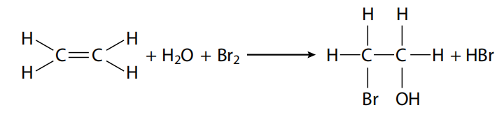
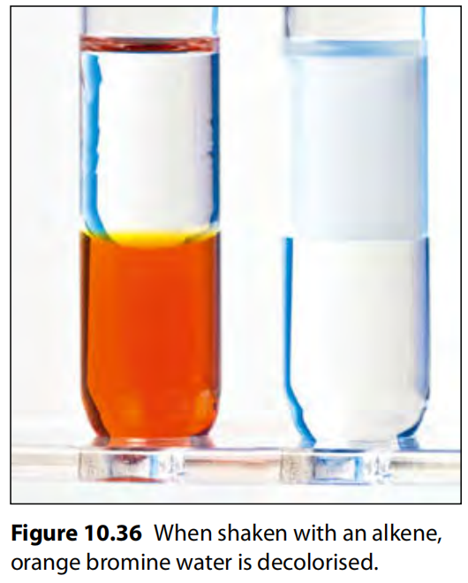

Slide 36
Addition of hydrogen halides
Hydrogen halides, such as HCl and HBr, react with alkenes to produce halogenoalkanes.
When ethene gas is bubbled through a concentrated aqueous solution of hydrogen bromide, HBr, an addition reaction occurs fairly readily at room temperature, forming bromoethane.

Slide 37
Mechanism
The reaction occurs by a similar mechanism to that described above.
HBr as a polar molecule undergoes heterolytic fission to form H⁺ and Br⁻, and the electrophile, H⁺, makes the initial attack on the alkene’s double bond.
The unstable carbocation intermediate that forms from this step then reacts quickly with Br− to form the addition product.

Slide 38
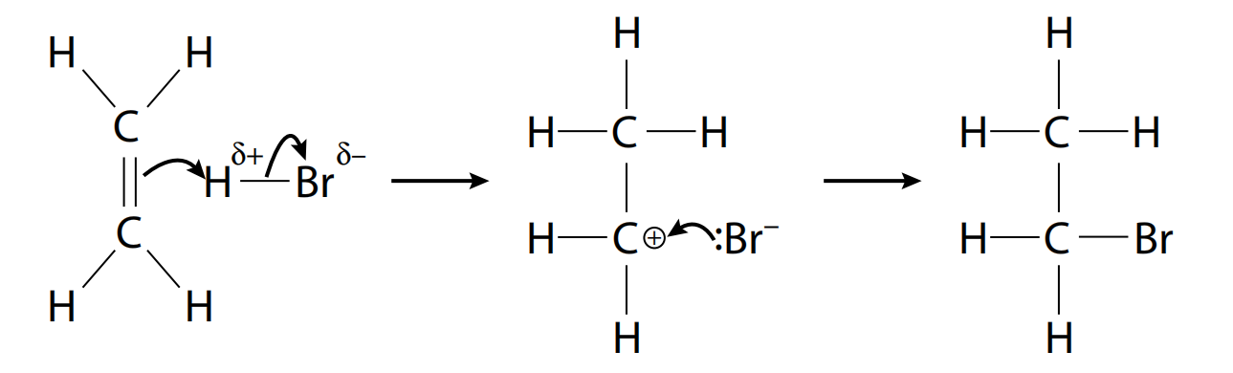

Slide 39
All the hydrogen halides are able to react in this way, but the reactivity is in the order HI > HBr > HCl due to the decreasing strength of the hydrogen halide bond down Group 17.
So HI, with the weakest bond, reacts the most readily.
One piece of evidence that supports this mechanism is that the reaction is favored by a polar solvent that facilitates the production of ions from heterolytic fission.
The other hydrogen halides react similarly with alkenes.
HI reacts more readily than HBr due to its weaker bond and HCl less readily due to its stronger bond.

Slide 40
asymmetric addition (HL Only)
When an asymmetric alkene such as propene is reacted with a hydrogen halide such as HBr, there are theoretically two different products that can form.
These are isomers of each other and they result from two possible pathways through the electrophilic addition mechanism described above.

Slide 41
The difference between these two depends on whether the attacking electrophile (H⁺ formed from heterolytic fission of HBr) is more likely to bond to the carbon labelled 2, as in mechanism (a) above, or to carbon labelled 1, as in mechanism (b).
It is dependent on which pathway will give the most stable carbocation during the addition process.
Alkyl groups around a carbocation stabilize it somewhat due to their positive inductive effects, meaning that they push electron density away from themselves and so lessen the density of the positive charge.
In (a) above the carbocation is a primary carbocation and is stabilized by only one such positive inductive effect, whereas in (b), a secondary carbocation forms in which there are two such effects and the stabilization is greater.
Consequently, the more stable carbocation in (b) will be more likely to persist and react with Br⁻, leading to 2-bromopropane as the main product of the reaction.

Slide 43
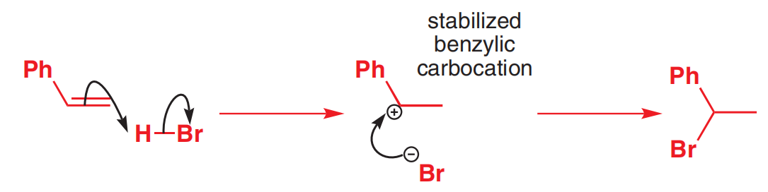
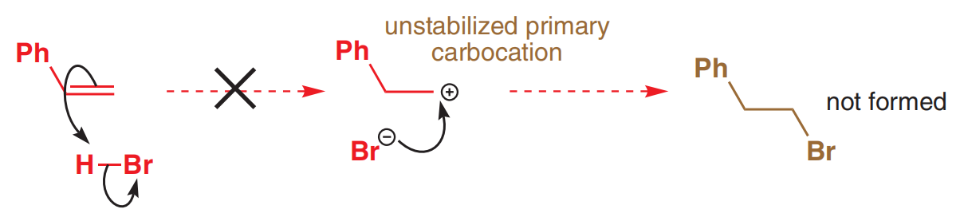
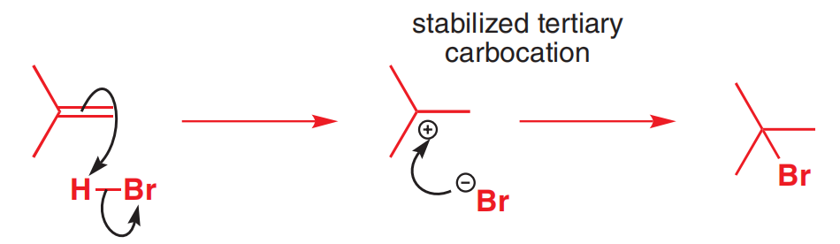

Slide 44
Markovnikov’s rule
Such an outcome for any reaction involving addition of a hydrogen halide to asymmetric alkenes by using what is known as Markovnikov’s rule.
This states: the hydrogen will attach to the carbon that is already bonded to the greater number of hydrogens.
As we have seen, this is based on the fact that the mechanism that proceeds via the most stable carbocation will be favoured.
In more general terms Markovnikov’s rule can be stated as the less electronegative part of the reacting species bonds to the least highly substituted carbon atom in the alkene (the one with the smaller number of carbons attached).
Applying this rule enables us to predict the outcomes from any reactions involving asymmetric reagents undergoing addition reactions with asymmetric alkenes.

Slide 47
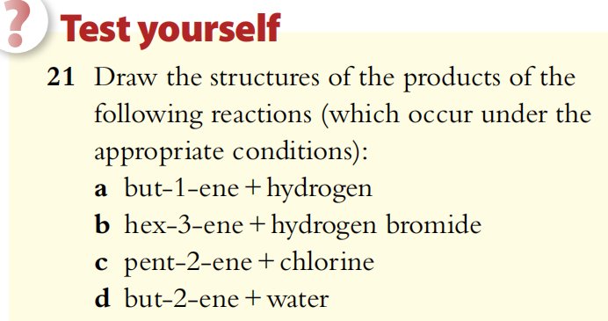
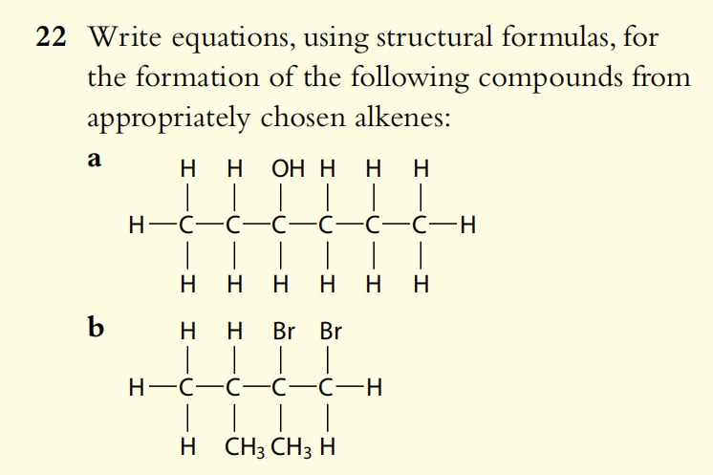
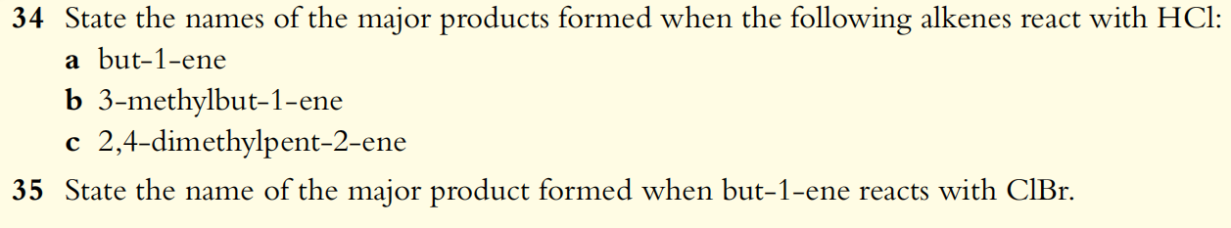

Slide 48
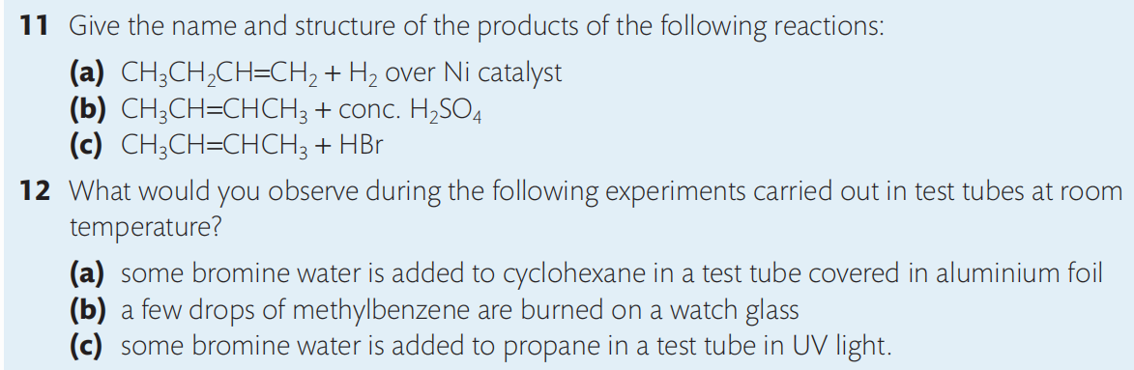
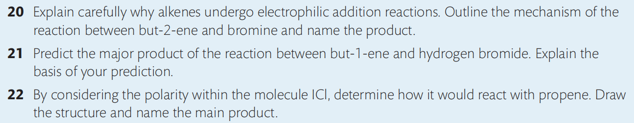

Slide 49
Polymers
Polymers are a class of covalently bonded materials characterized by their low thermal and electrical conductivity, and low density compared to other types of materials.
Polymers are macromolecules, which are very large molecules.
Synthetic polymers include plastics and synthetic textiles such as nylon.
Natural polymers include fibrous materials like lignin and silk, as well as many of the biological molecules involved in life processes, such as DNA, starch and proteins.
Long, covalently bonded polymer chains are made when small molecules called monomers join end-to-end, like beads strung together to create a necklace. This process is called polymerization. There are two types of polymerization: addition and condensation.

Slide 50
Addition Polymerization
Because alkenes readily undergo addition reactions by breaking their double bond, they can be joined together with each other to produce long chains known as addition polymers.
The alkene used in this reaction is known as the monomer, and its chemical nature determines the properties of the polymer.
Polymers, typically containing thousands of molecules of the monomer, are a major product of the organic chemical industry and many of our most familiar and useful plastics are polymers of alkenes.

Slide 51
As polymers are such large molecules, their structures are shown using a repeating unit, which has open bonds at each end.
It is put in a bracket with n as subscript to denote the number of repeating units.
For example, ethene polymerizes to form poly(ethene), commonly known as polythene.

Slide 52
Similarly, propene polymerizes to form poly(propene), often called polypropylene.
Other common addition polymers include PVC, poly(chloroethene), and PTFE, poly(tetrafluoroethene), often marketed as Teflon®. Their repeating units are given below.

Slide 53
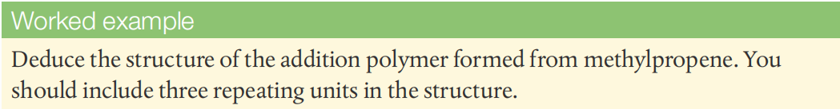
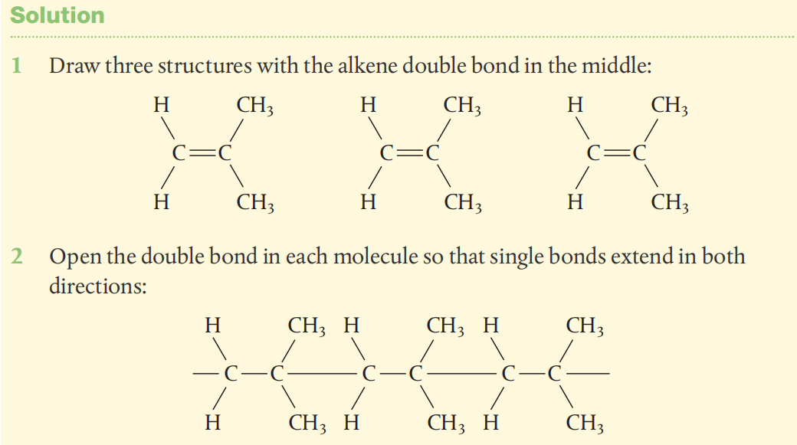

Slide 54
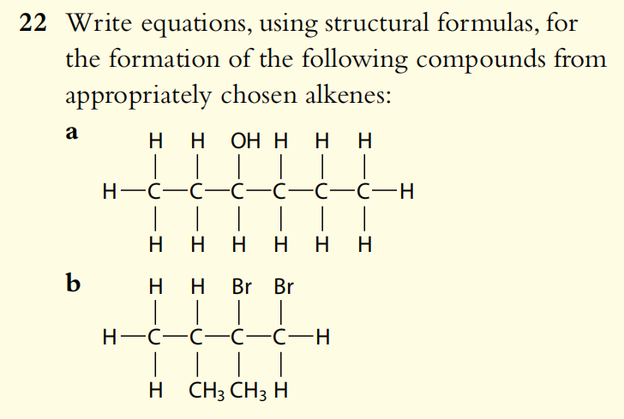
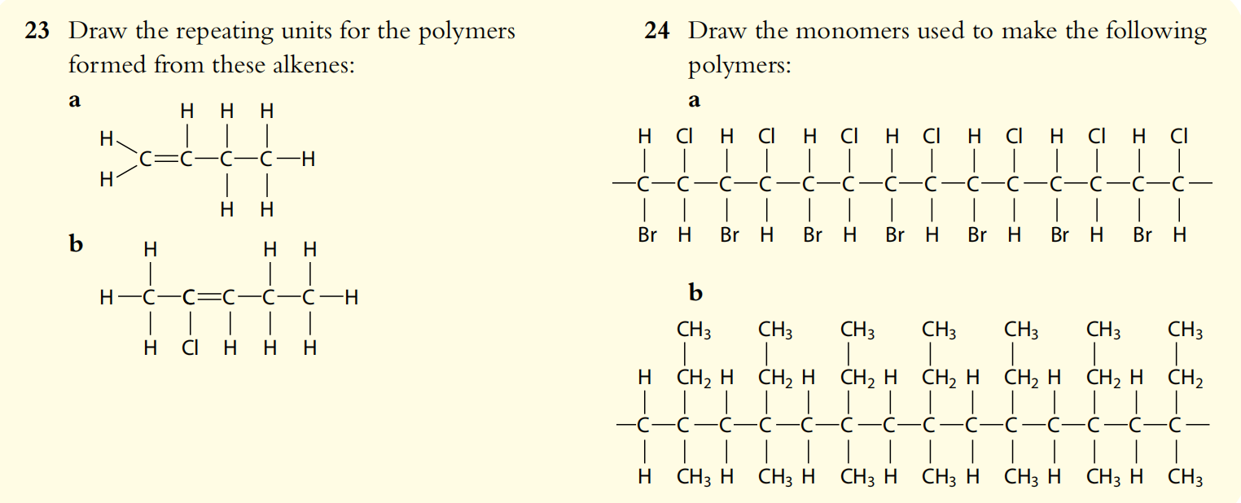

Slide 55
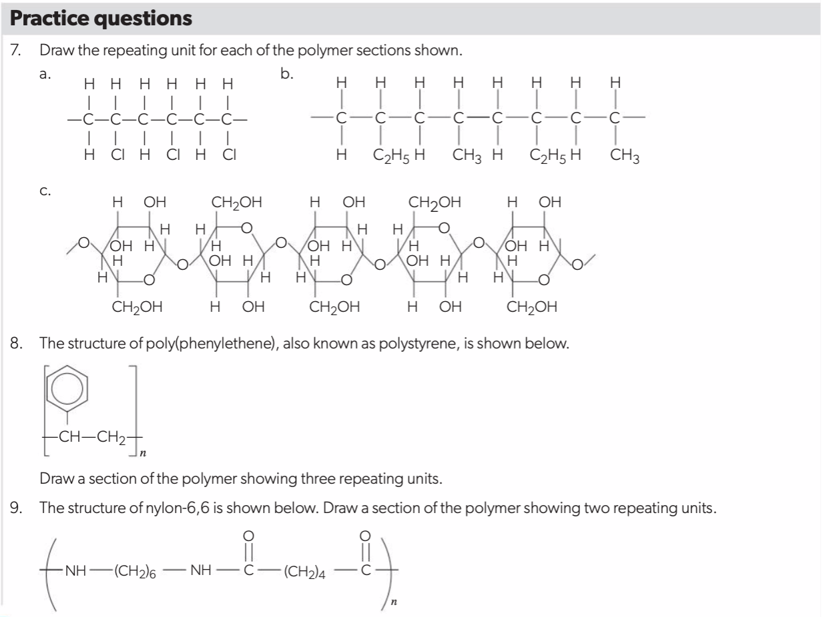

Slide 56
Properties of polymers
In general, polymers are strong, because of their macromolecular nature. Like most covalent materials, they do not contain moving charged particles, so their thermal and electrical conductivities are low.
Though molecular, polymers have relatively high melting points and boiling points. This is due to the number of intermolecular forces that occur along the length of the polymer molecules. The long polymer strands can also wind around each other and become entangled, requiring energy to disentangle and separate them.
The specific properties of a polymer depend on its chain length, the type of forces holding the chains together, the type of monomers and the way these monomers are arranged.

Slide 57
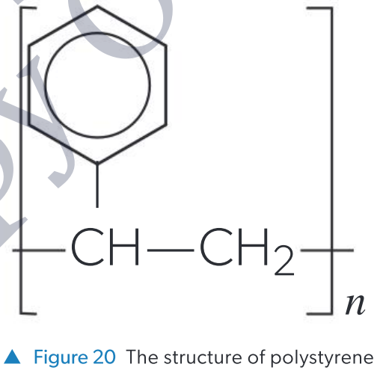
Plastics
Plastics are synthetic addition polymers composed mainly of carbon and hydrogen.
They are often chemically unreactive, although they can catch fire and sustain combustion.
Poly(phenylethene), commonly known as polystyrene, is a widely used plastic found in packing peanuts and food containers.
Polystyrene is a non-polar hydrocarbon and so it is insoluble in water. London dispersion forces (LDFs) hold the polymer chains together. These LDFs can be overcome by heating, so polystyrene can be melted down and reshaped easily. On cooling, new LDFs can form between polystyrene molecules, so the polymer solidifies again.

Slide 58
Polystyrene chains cannot rotate easily due to the bulky phenyl groups (C₆H₅-), making it brittle. Polystyrene is a good thermal insulator, particularly in its expanded form, so it is used to make coolers and insulating panels for the construction industry.
One of the reasons plastics are useful is that, due to their strong covalent bonds, they are chemically inert and therefore durable. As a result, many plastics are not typically biodegradable.
Biodegradation involves the breakdown of materials into small molecules by microorganisms. Polymers rarely contain reactive functional groups that could act as bacterial binding sites.
In some plastics, the polymer chains are covalently bonded together, which is known as crosslinking.
A dense covalent network formed by crosslinking provides very few entry points for microorganisms.

Slide 59
Microplastics
Microplastics are very small fragments of plastic, broken down over time to sizes under 5mm.
This process is not the same as biodegradation because the plastics remain chemically unchanged.
Because of their size, they can enter the food chain and find their way into unexpected places.
In 2022, microplastics of PET, polystyrene and polyethene were discovered in human blood for the first time.
Their health impact of microplastics is still unknown.

Slide 60
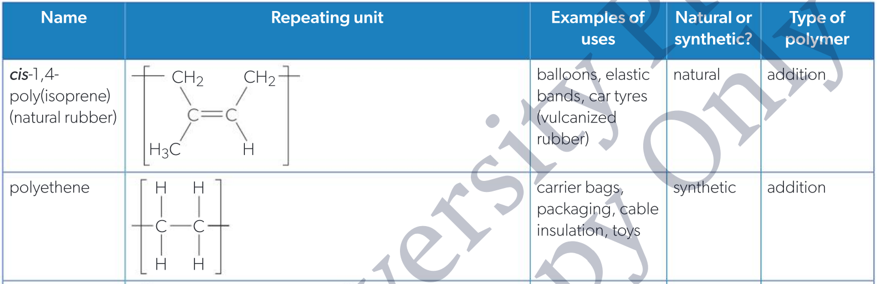

Slide 61
Plastics and envrionment
After reduction and reuse, recycling is the third approach for mitigating the environmental impact of plastics. Plastic recycling poses several challenges.
The process is energy-intensive: plastic waste must be sorted and cleaned beforehand. It then needs to be broken up and melted, which prevents some plastic types from being recycled because they release atmospheric pollutants on heating.
Unlike glass and aluminium, where the quality is largely unaffected by recycling, plastics often deteriorate when they are recycled.
As a result, most plastic waste is not recycled and is instead incinerated or disposed of in landfills.
Much of discarded plastic ends up in the oceans, where it persists and poses a risk to wildlife.

Slide 62
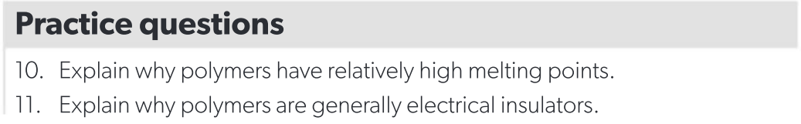
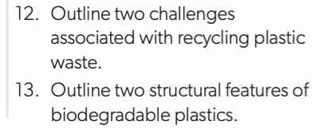

Slide 63
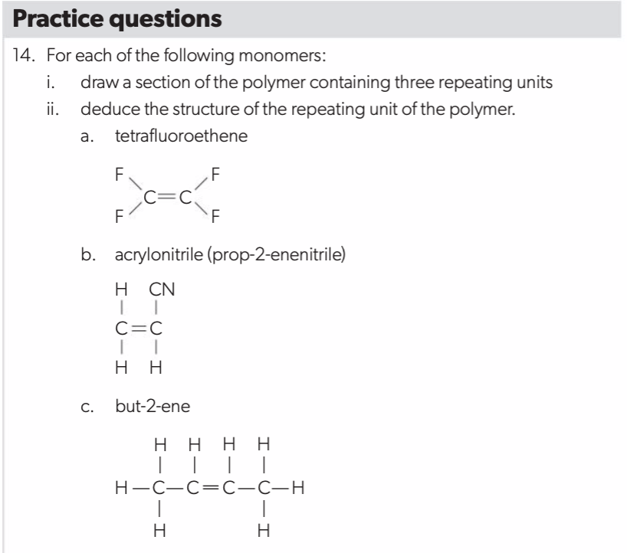

Slide 64
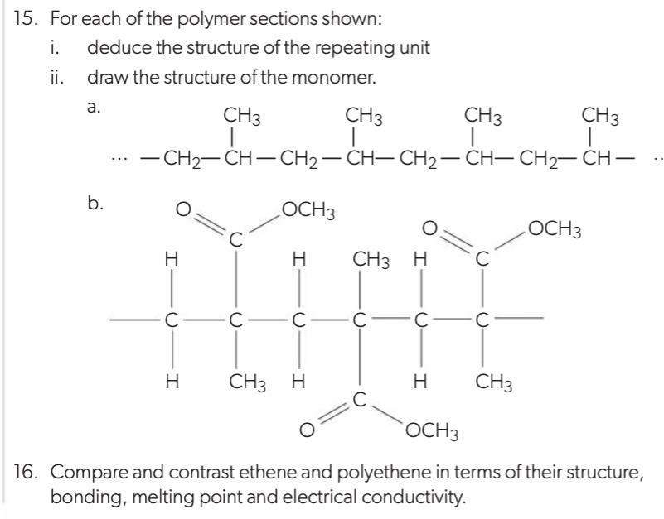

Slide 65
Summary of alkenes
In summary, alkenes:
readily undergo electrophilic addition reactions
are used as starting materials in the manufacture of many industrially important chemicals.

Slide 67
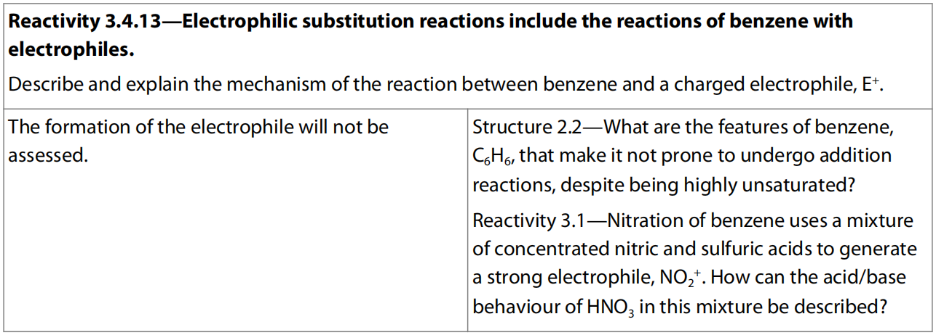
14.3 Electrophilic Substitution (Higher Level)

Slide 68
Electrophilic substitution reactions of benzene
Despite its high unsaturation, benzene does not behave like alkenes in its characteristic reactions.
Its unusual and highly stable aromatic ring determines that substitution, not addition, is its favored reaction.
Nonetheless, like alkenes, benzene is attractive to electrophiles because its ring is a region of relatively high electron density.
The delocalized cloud of π electrons seeks electron-deficient species and forms a new bond as a hydrogen atom is lost.
The reactions are therefore electrophilic substitution.

Slide 69
The mechanism of the electrophilic substitution reactions of benzene follows a similar path with different electrophiles.
The reaction has high activation energy and so proceeds rather slowly.
This is because the first step in the mechanism, in which an π electron pair from benzene is attracted to the electrophile, leads to a disruption of the symmetry of the delocalized system.
The unstable carbocation intermediate that forms has both the entering atom or group and the leaving hydrogen temporarily bonded to the ring.

Slide 70
Using E⁺ to represent an electrophile, we can show the reaction as follows.
The incomplete circle inside the ring shows its loss of symmetry, with the positive charge distributed over the bulk of the molecule.
Loss of a hydrogen ion, H⁺, from this intermediate leads to the electrically neutral substitution product as two electrons from the C–H bond move to regenerate the aromatic ring.
This product is more stable, as shown in diagram in the next slide.

Slide 71
These reactions can be used with different electrophiles to introduce different functional groups into the ring.

Slide 72
Chlorination of benzene
The chlorination of benzene is the substitution of –H by –Cl to form chlorobenzene, C₆H₅Cl.
The electrophile for the reaction is Cl⁺, the chlorine cation.
This is generated by reacting chlorine gas with aluminum chloride at 55-60°C.
As aluminum chloride is a good Lewis acid, which would bond to one of the chlorine atom with the pair of shared electrons, leaving the other chlorine atom as Cl⁺ ion.

Slide 74
No water is allowed to get involved in this reaction, otherwise AlCl₃ would dissociate to form Al³⁺ and Cl⁻ so it would no longer be able to react with Cl₂ as the Lewis acid to form Cl⁺.
The overall reaction is:

Slide 75
Nitration of benzene
The nitration of benzene is the substitution of –H by –NO₂ to form nitrobenzene, C₆H₅NO₂.
The electrophile for the reaction is NO₂⁺, the nitronium ion.
This is generated by using a nitrating mixture, a mixture of concentrated nitric acid and concentrated sulfuric acids at 50°C.
As the stronger of the two acids, sulfuric acid protonates the nitric acid, which then loses a molecule of water to produce NO₂⁺.

Slide 77
NO₂⁺ is a strong electrophile and reacts with the π electrons of the benzene ring to form the carbocation intermediate.
Loss of a proton from this leads to reformation of the arene ring in the product nitrobenzene, which appears as a yellow oil.
The hydrogen ion released reacts with the base HSO₄⁻ to reform sulfuric acid, H₂SO₄.
The overall reaction is:

Slide 78
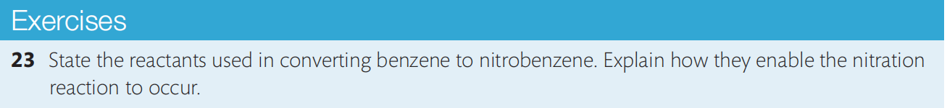
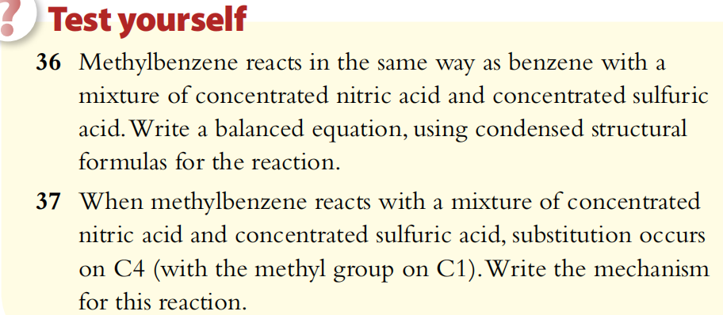

Slide 79
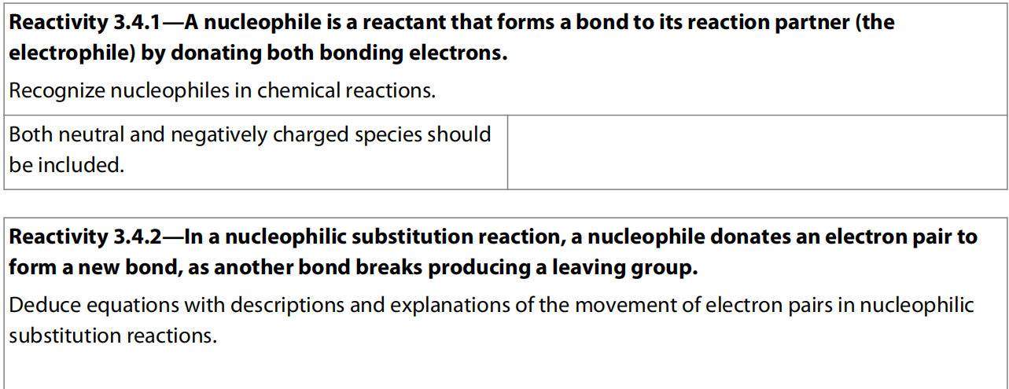
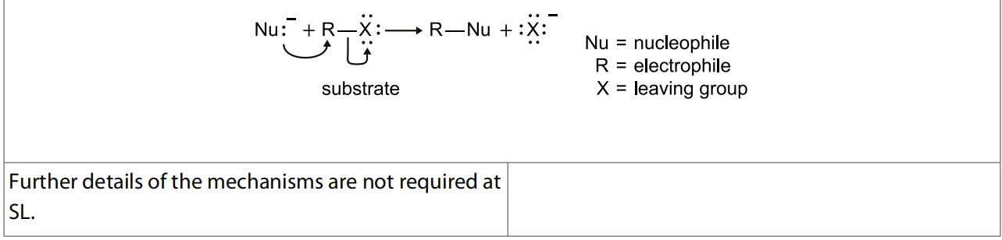
14.4 Nucleophilic Substitution

Slide 80
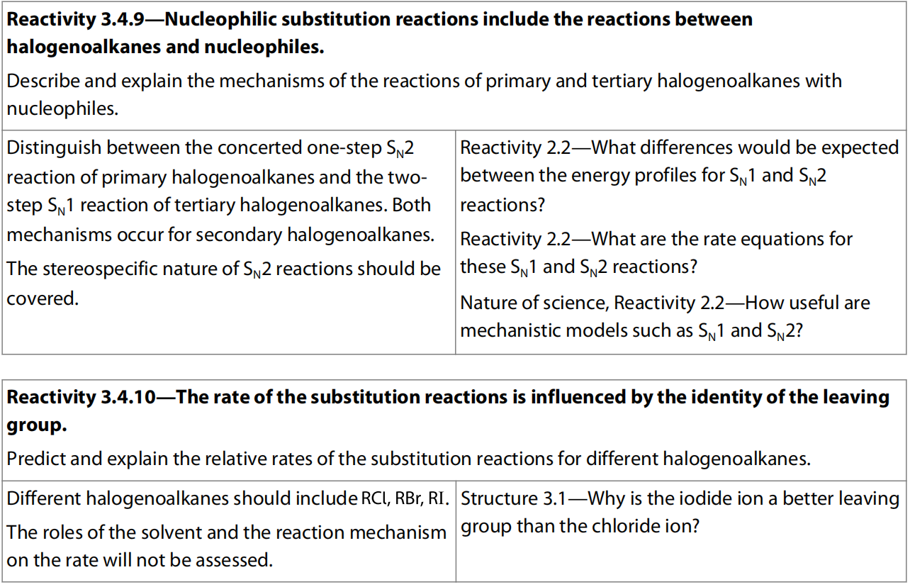
HL Only
HL Only

Slide 81
Halogenoalkanes
General formula is C_{n}H_{2n+1}X (where X = halogen)
Halogenoalkanes contain an atom of fluorine, chlorine, bromine, or iodine bonded to the carbon skeleton of the molecule.
Halogenoalkanes are saturated molecules so, like alkanes, their reactions involve substitution – that is the replacement of one atom by another atom or group.
But, unlike the alkanes, the halogenoalkanes possess a polar bond and this makes them more reactive.

Slide 82
Nucleophilic substitution reactions of halogenoalkanes
The shorthand notation S_{N} – substitution nucleophilic – is used for this type of reaction.
The polar carbon–halogen bond in halogenoalkanes means that the carbon atom is electron deficient, and it is attacked by nucleophiles such as OH–.
During these reactions, the carbon–halogen bond breaks and the halogen atom is released as a negative ion (the halide).
This type of bond breakage, where both the shared electrons go to one of the products, is known as heterolytic fission.
The halogen, because it becomes detached in the reaction, is known as the leaving group.

Slide 83
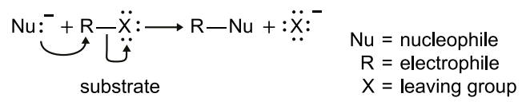
Nucleophiles are reactants that are themselves electron rich, as they have a lone pair of electrons and may also carry a negative charge, such as OH–, H₂O, CN–, and NH₃.
These species are therefore attracted to the electron-deficient carbon atom in the halogenoalkane.
This leads to reactions in which substitution of the halogen occurs, known as nucleophilic substitution reactions.
For example, halogenoalkanes react with alkalis such as NaOH to form alcohols: RX + OH– → ROH + X–.

Slide 84
Mechanisms (Higher Level)
There are two different types of nucleophilic substitution, S_{N}1 and S_{N}2.
The letter S and N represent substitution and nucleophilic respectively, and the number 1 or 2 represents the order of the nucleophilic substitution reaction, i.e. how many molecules of reactants in the rate-determining step in the overall reaction.
Therefore, S_{N}1 represents a nucleophilic substitution reaction that has only one molecule of reactant in the rate-determining step, actually the halogenoalkane, so the rate equation of S_{N}1 is: rate = k [RX].
Similarly, S_{N}2 represents a nucleophilic substitution reaction that has two reactant molecules in the rate-determining step, so the rate equation of S_{N}2 is: rate = k [RX] [OH–].

Slide 85
Primary halogenoalkanes: S_{N}2 mechanism
Primary halogenoalkanes have at least two hydrogen atoms attached to the carbon of the carbon–halogen bond.
For example chloroethane:
The overall reaction that occurs with NaOH is:
As the hydrogen atoms are so small, the carbon atom is relatively open to attack by the nucleophile.
An unstable transition state is formed in which the carbon is weakly bonded to both the halogen and the nucleophile.
The carbon–halogen bond then breaks heterolytically, releasing Cl⁻ and forming the alcohol product.

Slide 86
Tetrahedral
Trigonal bipyramidal
Tetrahedral
Effectively this is a one-step concerted reaction with a most unstable transition state.
Because the mechanism is dependent on the concentration of both the halogenoalkane and the hydroxide ion, it is known as a bimolecular reaction.
rate = k [halogenoalkane] [nucleophile]
Therefore this mechanism is fully described as S_{N}2: substitution nucleophilic bimolecular.

Slide 87
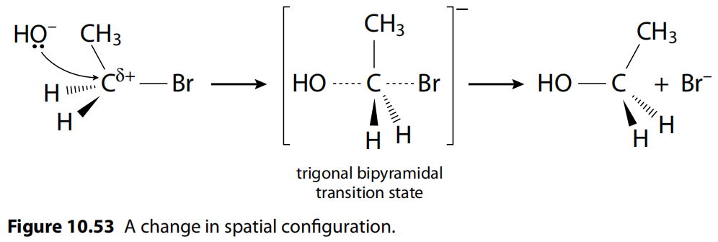
Note that the nucleophile attacks the electrophilic carbon atom on the opposite side from the leaving group, which causes an inversion of the arrangement of the atoms around the carbon atom.
If the carbon atom that halogen bonds to is a chiral carbon, then the configuration around this carbon atom would be converted to one form to the other.
Therefore, if the reactant only contain one single optical isomer, then the product would also be one optical isomer but only if the reactant exclusively undergo S_{N}2 mechanism (actually not possible).

Slide 88
These configurations are a result of different spatial arrangements around tetrahedrally bonded carbon atoms.
This topic is discussed more fully in Section 20.3.
The S_{N}2 mechanism is described as stereospecific because the three-dimensional arrangement of the reactants determines the three-dimensional configuration of the products.
This happens because bond formation comes at the same time as bond cleavage in the transition state, so the stereochemistry of the carbon attacked is not lost.

Slide 89
Stereospecific reactions are important in the synthesis of biological molecules such as amino acids, and in many drug syntheses.
The S_{N}2 mechanism is favoured by polar, aprotic solvents.
Aprotic solvents are those which are not able to form hydrogen bonds as they do not contain –OH or –NH bonds, although they may have strong dipoles.
This means they solvate the metal cation (e.g. Na⁺) rather than the nucleophile (OH–).
The unsolvated, bare nucleophile is less stable and this increases the reaction rate.
Suitable solvents include propanone, (CH₃)₂CO, and ethanenitrile, CH₃CN.

Slide 90
Tertiary halogenoalkane: S_{N}1 mechanism
Tertiary halogenoalkanes have three alkyl groups attached to the carbon of the carbon–halogen bond.
2-chloro-2-methylpropane is an example:
The overall reaction that occurs with NaOH is:

Slide 91
Here the presence of the three alkyl groups around the carbon of the carbon–halogen bond causes what is called steric hindrance, meaning that these large groups make it difficult for an incoming group (the nucleophile) to attack this carbon atom.
Instead, the first step of this type of reaction only involves the breaking of the carbon–halogen bond heterolytically.
As the halide ion is detached, this leaves the carbon atom with a temporary positive charge, which is known as a carbocation intermediate.
This is then attacked by the nucleophile in the second step of the reaction, leading to the formation of a new bond.

Slide 92
Tetrahedral
Triangular planar
Triangular planar
Tetrahedral

Slide 93
Another reason which favors this mechanism in tertiary halogenoalkanes is that the carbocation is stabilized by the presence of the three alkyl groups, as each of these has an electron-donating or positive inductive effect, shown by the blue arrows in the diagram.
This stabilizing effect helps the carbocation to persist for long enough for the second step to occur.
Because the slow step of this reaction, the rate-determining step, is determined by the concentration only of the halogenoalkane, it is described as a unimolecular reaction.
rate = k [halogenoalkane]
Therefore this reaction mechanism is fully described as S_{N}1: substitution nucleophilic unimolecular.

Slide 94
The carbocation intermediate has a trigonal planar shape since it is no longer experiencing the sp³ hybridization but sp² instead with another vacant 2p orbital, which means the nucleophile can attack from either of the two (up and under) position in the second step.
This means that the S_{N}1 reaction is not stereospecific.
It can in fact give rise to a 50-50 mixture of a pair of enantiomers, known as a racemic mixture.
The influence of solvents on the S_{N}1 reaction is mostly a result of their ability to stabilize the carbocation intermediate.
Anything that stabilizes the intermediate will favor the reaction.
Polar, protic solvents contain – OH or – NH bonds and so are able to form hydrogen bonds.
They are effective in stabilizing the positively charged intermediate by solvation involving ion–dipole interactions.
Suitable solvents include water, alcohols, and carboxylic acids.

Slide 96
Secondary halogenoalkanes
It is not possible to be precise about the mechanism of nucleophilic substitution in secondary halogenoalkanes, as data show that they usually undergo a mixture of both S_{N}1 and S_{N}2 mechanisms.
Even primary and tertiary halogenoalkanes would not exclusively undergo only S_{N}1 or S_{N}2.
Evidence can be the fact that the nucleophilic substitution products of tertiary halogenoalkanes would not be racemic mixture, and that of primary halogenoalkanes would also not be a single optical isomer.

Slide 97
Comparison of the rates of nucleophilic substitution reactions: 1. The effect of the mechanism
Experimental data have shown that the S_{N}1 mechanism proceeds more quickly than the S_{N}2 mechanism.
So substitution reactions occur more quickly with tertiary halogenoalkanes than with primary halogenoalkanes.
Secondary halogenoalkanes using a mixture of both mechanisms show an intermediate rate of reaction.
The relative rate of reactivity of the three classes of halogenoalkane when all other variables are kept constant is:
tertiary > secondary > primary S_{N}1 S_{N}1 and S_{N}2 S_{N}2

Slide 98
2. The influence of the leaving group (halogen) (a) The polarity of the carbon–halogen bond
As the electronegativity of the halogens decreases in going down the group from fluorine to iodine, the carbon of the carbon–halogen bond becomes progressively less electron deficient and so less vulnerable to nucleophilic attack.
So from this we would expect:
fluoroalkane > chloroalkane > bromoalkane > iodoalkane

Slide 99
(b) The strength of the carbon–halogen bond
Bond enthalpy data show that the carbon–halogen bond decreases in strength from fluorine to iodine.
As the substitution reaction involves breaking this bond, we would expect the ease of breaking bonds to be:
C –– I > C –– Br > C –– Cl > C –– F
Reaction rate data (S_{N}1 is normally faster than S_{N}2) indicate that, the strength of the carbon–halogen bond, dominates the outcome here.
So in summary, the relative rate of reaction of the different halogens in halogenoalkanes when all other variables are kept constant is therefore:
iodoalkanes > bromoalkanes > chloroalkanes > fluoroalkanes

Slide 100
3. Choice of solvent
As explained above, the S_{N}1 mechanism is favored by polar, protic solvents, while the S_{N}2 mechanism is favored by polar, aprotic solvents.
So, overall, the fastest reactions will occur with tertiary iodoalkanes in polar, protic solvents.
Nucleophilic substitution reactions of halogenoalkanes can be followed by the appearance of the halide ion.
Silver nitrate solution, AgNO₃ (aq), added to the reaction mixture reacts with the halide ion, forming a precipitate of the silver halide, each with a distinct colour.

Slide 101
Note that in these reactions, primary alcohols are produced from primary halogenoalkanes, secondary alcohols from secondary halogenoalkanes, and so on.
This will be useful in the consideration of synthetic pathways in Section 20.2.

Slide 102
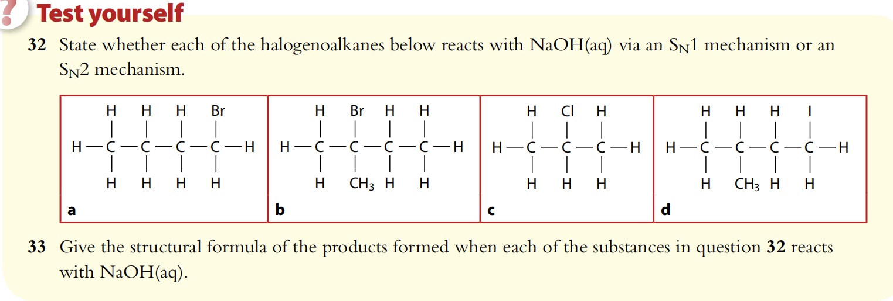

Slide 103
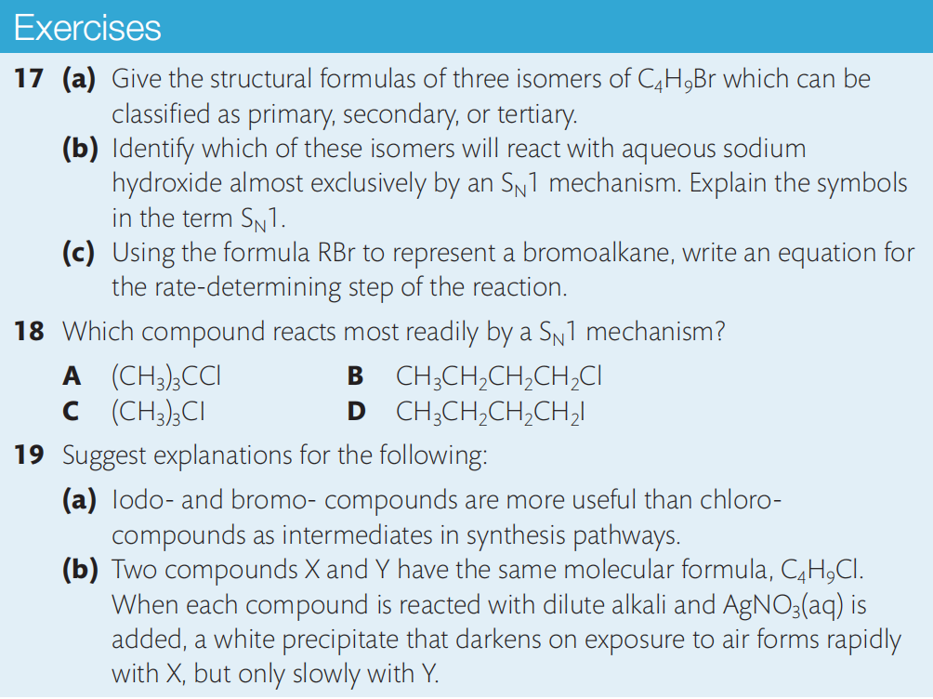

Slide 104
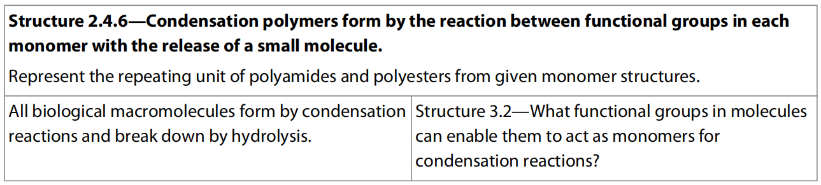
14.5 Condensation (Higher Level)

Slide 105
Alcohols
General formula C_{n}H_{2n+1}OH
Alcohols have –OH functional group
The –– OH group is polar, and so increases the solubility in water of the molecules, relative to alkanes of comparable molar mass.
The most common alcohol, ethanol (C₂H₅OH), is soluble in water in all proportions, as we know from its presence in alcoholic drinks.

Slide 106
Esterification reaction
Alcohols react with carboxylic acids to form esters in a condensation reaction in which water is also produced.
This is a reversible reaction:
carboxylic acid + alcohol ⇌ ester + water
The reaction is an equilibrium reaction, and is catalyzed by concentrated sulfuric acid, H₂SO₄.
The ester has the lowest boiling point of the components of the reaction mixture and so can be separated by distillation.
Esters have distinct smells that can often be detected if the reaction mixture is poured into a beaker of water.
Unlike their parent acid and alcohol, esters have no free –OH groups so they cannot form hydrogen bonds and so are mostly quite insoluble and form a layer on the surface.

Slide 108
Some other esterification reactions are given below.

Slide 109
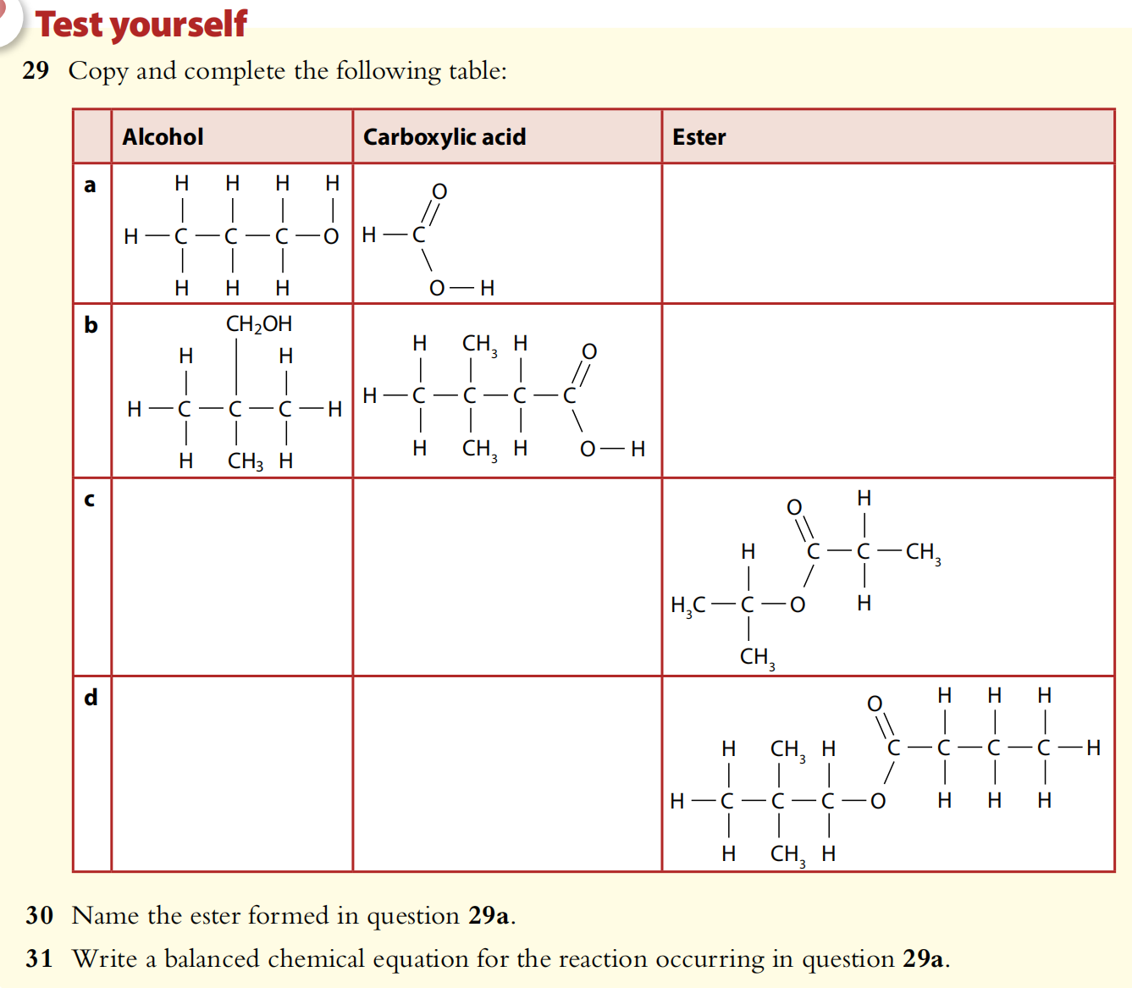
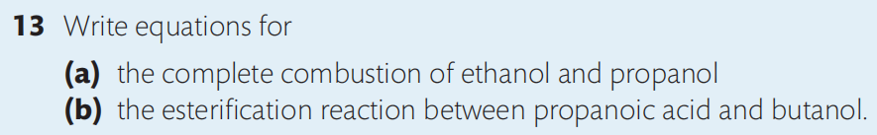

Slide 110
Condensation polymers
Condensation polymers, which include nylon and cellulose, are produced in a reaction between monomers that have reactive functional groups on either end.
For every bond formed between two monomers, a small molecule is released (for instance, water or HCl).
The reactions used to make condensation polymers are similar to esterification: two functional groups react to form a linkage, and a small molecule is released.
However, in polymerization, the reacting monomers have two reactive functional groups, one at each end of the molecule, which allows a polymer chain to form. We will look at two examples of how this can happen.

Slide 111
Condensation between two different monomers
One monomer with the same functional group at either end can react with another monomer with a different functional group at either end.
This creates a polymer of alternating monomer structure: for example, if monomer A reacts with monomer B, a polymer with the pattern ABABABAB is formed.
The general reaction between a dicarboxylic acid monomer and difunctional alcohol (diol) monomer to form an ester linkage is shown below.

Slide 112
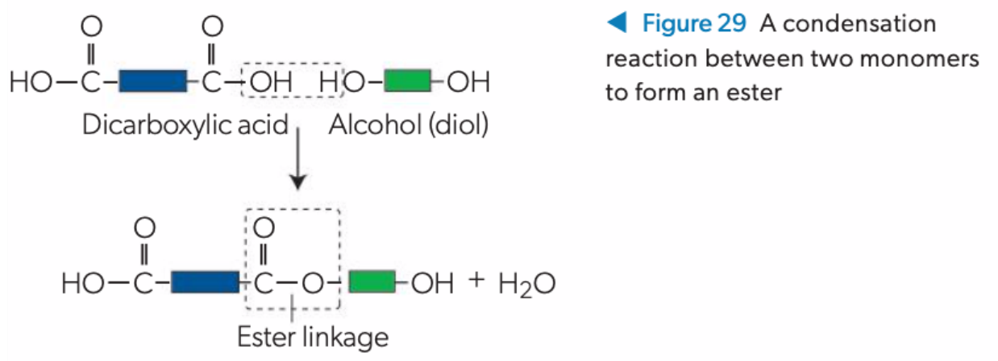
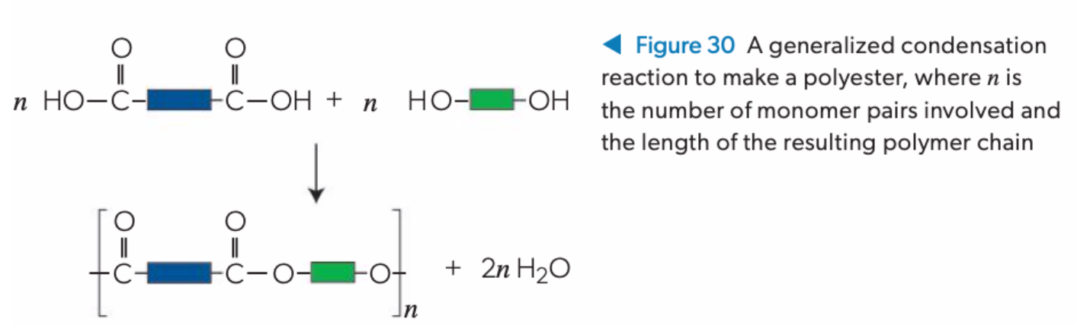

Slide 113
The product molecule has two reactive ends that can subsequently react with more monomers.
This forms a long polymer chain with an alternating pattern based on each monomer structure, with each monomer joined by an ester linkage.
The resulting polymer product is called a polyester.

Slide 114
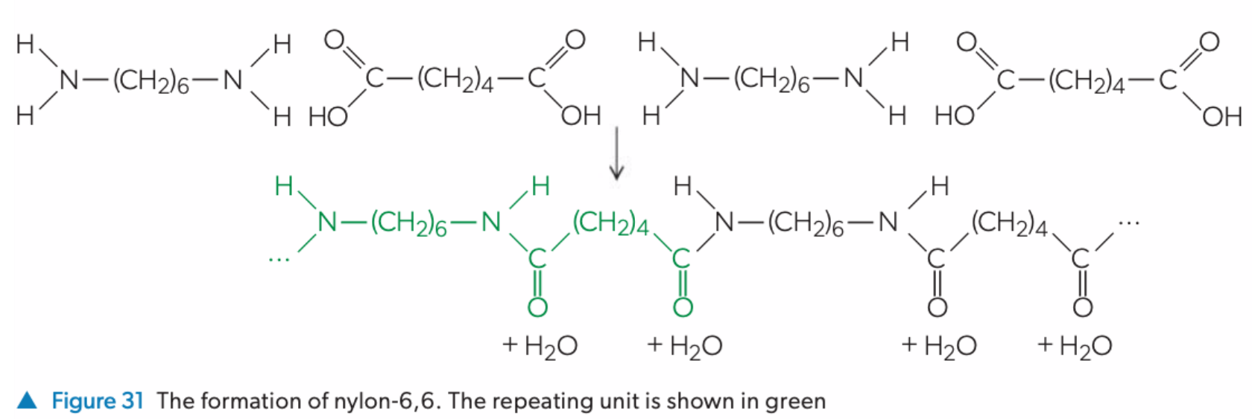
The polymer nylon-6,6 is produced in the condensation reaction between hexanedioic acid and hexane-1,6-diamine . The product is known as a polyamide due to the multiple amide linkages formed during the condensation reaction.

Slide 115
Condensation of the same monomer
If there is a different functional group on each end of a monomer which can undergo condensation reaction with each other, then it can polymerize with itself by condensation.
For example, 3-hydroxypentanoic acid (CH₃CH₂CH(OH)CH₂COOH) contains both a hydroxyl group and a carboxyl group.
Multiple monomers of 3-hydroxypentanoic acid can react with one another to form polymer.

Slide 116
Proteins are biopolymers that play a central role in metabolic processes, transport and sensory functions, structural integrity, and virtually all other molecular aspects of life.
Proteins are polypeptides, which are polymers made up of monomers called 2-amino acids.
There are 20 types of 2-amino acids used by living organisms as building blocks of proteins.
2-amino acids have an –NH₂ group and a –COOH group, so they can form amide linkages with each other through condensation polymerization.
In a polypeptide, the amide link is also known as a peptide bond.

Slide 117
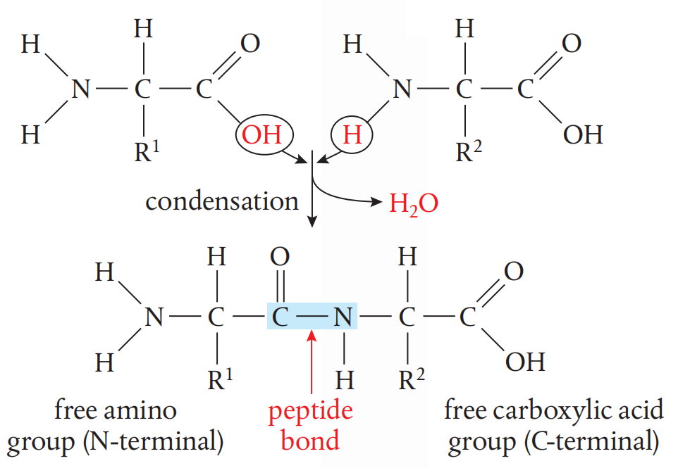

Slide 118
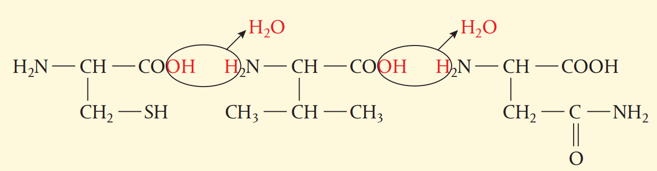
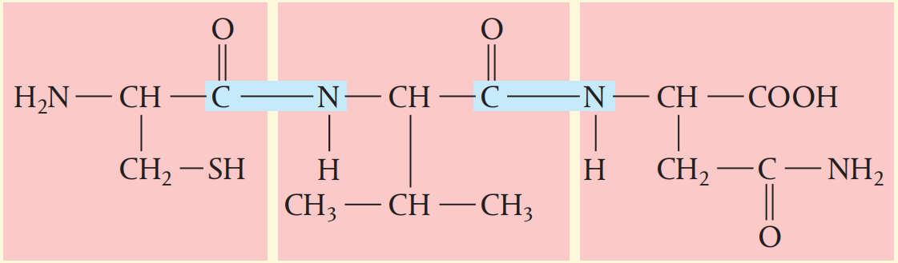

Slide 119



Slide 120


Slide 121

14.6 Oxidation of organic compounds

Slide 122
Oxidation of alcohols
Combustion involves the complete oxidation of the alcohol molecules, but it is also possible for them to react with oxidizing agents which selectively oxidize the carbon atom attached to the –OH group, keeping the carbon skeleton of the molecule unchanged.
In this way, alcohols can be oxidized into other important organic compounds.
The products of these reactions are determined by whether the alcohol is primary, secondary, or tertiary.

Slide 123
Oxidation of alcohols
Various oxidizing agents can be used for these reactions, one of which used in the laboratory process is acidified potassium dichromate (K₂Cr₂O₇ / H⁺) / acidified potassium permanganate.
Potassium dichromate is a bright orange solution owing to the presence of Cr₂O₇²⁻, which is reduced to green Cr(III) (Cr³⁺) as the alcohol is oxidized on heating.
Potassium permanganate is a purple solution because of the MnO₄⁻, which is reduced to pale pink or colorless Mn(II) (Mn²⁺) in this reaction on heating.
When writing these reactions it is often easier to show the oxidizing agent simply as ‘+ [O]’, which means whatever oxidant that provides one oxygen atom during the oxidation process.
The oxidation reactions of the different alcohols are as follows.

Slide 124

Primary alcohols
Primary alcohols are oxidized in a two-step reaction, first forming the aldehyde, which under prolonged conditions is oxidized further to the carboxylic acid.
Cr₂O₇²⁻ + H⁺ → Cr³⁺
orange green
This is why when we leave a bottle of wine exposed to the air, bacteria slowly oxidize the ethanol to ethanoic acid, giving the smell of vinegar.

Slide 125

The only changes involve the groups highlighted in red – the rest of the molecule is unchanged.

Slide 126
Not Required

Slide 127
It is possible to stop the reaction after the first step and obtain the aldehyde product by using distillation to remove it from the reaction mixture.
The alcohol used in the reaction would be better to be in excess.
This is possible because aldehydes have lower boiling points than either alcohols or carboxylic acids, because they do not have hydrogen bonding between their molecules.

Slide 128

Distillation Setup

Slide 129
If, on the other hand, we want to obtain the carboxylic acid as the product, then we must leave the aldehyde in contact with the oxidizing agent for a prolonged period of time.
This will be achieved most efficiently using apparatus for reflux since it would prevent the produced aldehyde from escape and force it to be further oxidized.
The alcohol used should be limiting and the oxidizing agent (potassium dichromate or potassium permanganate) would be in excess.

Slide 130

Reflux Setup

Slide 131

Secondary Alcohols
Secondary alcohols are oxidized to the ketone by a similar process of oxidation.
Cr₂O₇²⁻ + H⁺ → Cr³⁺
orange green

Slide 132

Tertiary alcohols
Tertiary alcohols are not readily oxidized under comparable conditions.
This would involve breaking the carbon skeleton of the molecule, which requires significantly more energy.
Therefore we will not see a colour change in the potassium dichromate(VI) oxidizing agent when it is reacted with a tertiary alcohol.
Cr₂O₇²⁻ + H⁺ → no color change
orange

Slide 134



Slide 135


14.7 Reduction of organic compounds

Slide 136
Reduction of carbonyl compounds: nucleophilic addition
We saw that the oxidation of alcohols to carbonyl compounds (those that contain the C=O group) takes place in the presence of a suitable oxidizing agent and yields different products depending on the alcohol and the conditions.
primary alcohol → aldehyde → carboxylic acid
secondary alcohol → ketone
We can reverse these reactions using a suitable reducing agent:
1. sodium borohydride, NaBH₄, in aqueous or alcoholic solution, or
2. lithium aluminium hydride, LiAlH₄, in anhydrous conditions, such as dry ether followed by aqueous acid.

Slide 137
Both reagents produce the hydride ion, H⁻, which acts as a nucleophile on the electron deficient carbonyl carbon.
NaBH₄ tends to be the safer reagent, but it is not reactive enough to reduce carboxylic acids, so LiAlH₄ must be used for this.
We can show these reactions using + [H] to represent reduction, in the same way as we used + [O] to represent oxidation of alcohols.
Some examples are given below.

Slide 138
+ 2 [H]
+ 2 [H]
+ 2 [H]

Slide 139
Not Required

Slide 140



Slide 141

Reduction of alkene & alkyne: Hydrogenation
Alkenes and alkynes are unsaturated compounds. Alkenes have a carbon–carbon double bond, and alkynes have a carbon–carbon triple bond.
Unsaturated compounds can be reduced by the addition of hydrogen to the multiple bond.
In the presence of a suitable catalyst, such as deactivated palladium, Pd(s), alkynes can be reduced by hydrogen gas to alkenes:
In this equation, the symbol R represents either an alkyl group or a hydrogen atom.

Slide 142


Alkenes are reduced by hydrogen gas to alkanes:
This reaction also requires a transition metal catalyst, such as Ni(s) or Pt(s). The same catalysts can be used to reduce alkynes directly to alkanes using excess hydrogen gas:
Reduction of alkynes and alkenes decreases the degree of unsaturation of these compounds.

Slide 143
This process, known as hydrogenation, is used in the margarine industry to convert oils containing many unsaturated hydrocarbon chains into more saturated compounds which have higher melting points.
This is done so that margarine will be a solid at room temperature.
However, there are now widespread concerns about the health effects of so-called trans fats, produced by partial hydrogenation of plant oils.

Slide 144


Slide 147

Summary of organic reactions

